Slide 1

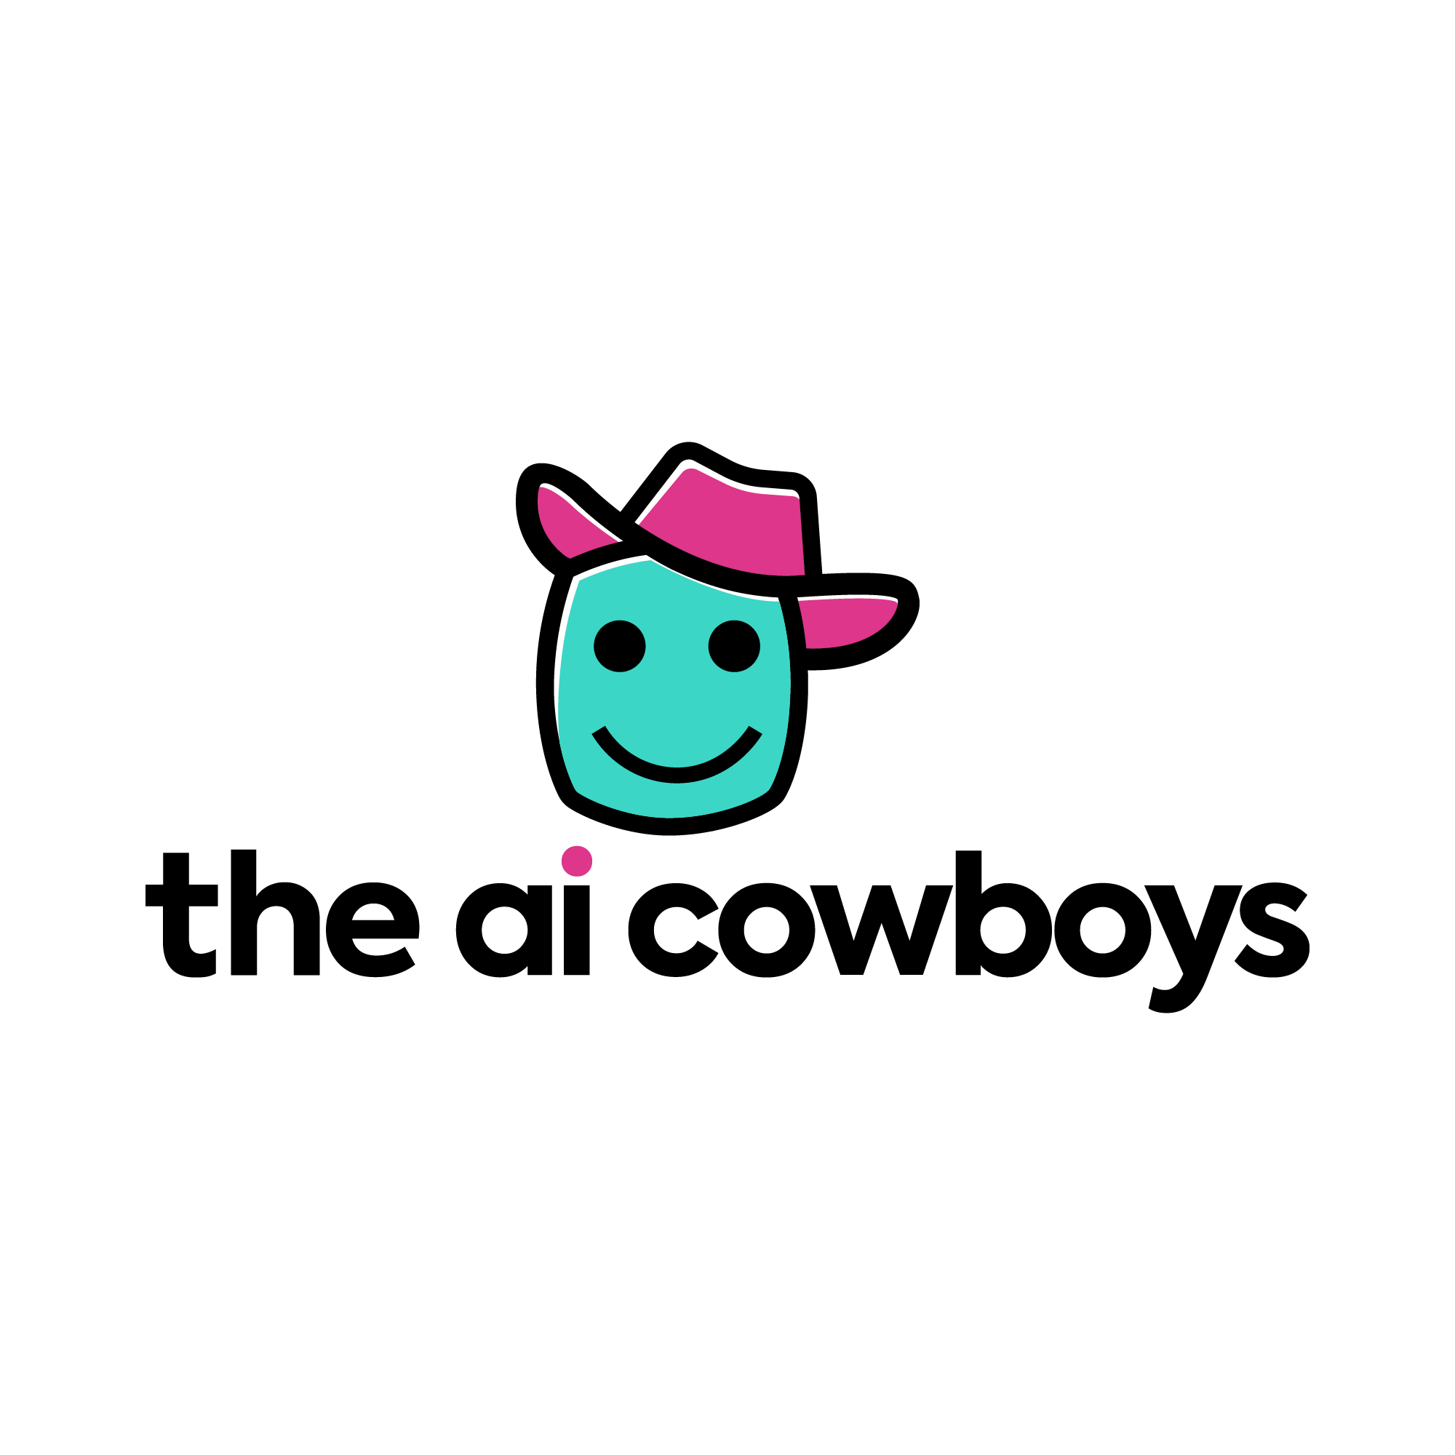

Vibe Coding AI Solutions
Workshop
From Idea to Live App. No Coding Required.
Mike Pendleton & Roger Wong Won
AFSA International Convention & Summit 365 | Orlando, FL | August 7-13, 2026

Slide 2
What Even IS Vibe Coding?
It's building software by describing what you want
in plain English.
No semicolons. No brackets. No error messages.
Just vibes.
You say: "Build me a dashboard that tracks vehicle maintenance"
AI says: "Here's your app. Want me to add a search bar?"
The Pentagon already has 103,000+ AI agents built this way.
1.1 million sessions. 180,000 per week. This is real.
Today we teach you how to do it RIGHT.
The AI Cowboys | AFSA Summit 365 | Orlando, FL | August 2026

Slide 3
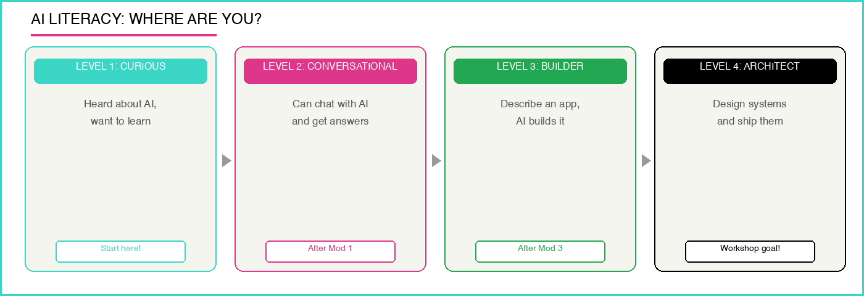
AI Literacy: Where Are You?
Goal: Take you to LEVEL 3+ by the end of this workshop!
The AI Cowboys | AFSA Summit 365 | Orlando, FL | August 2026

Slide 4
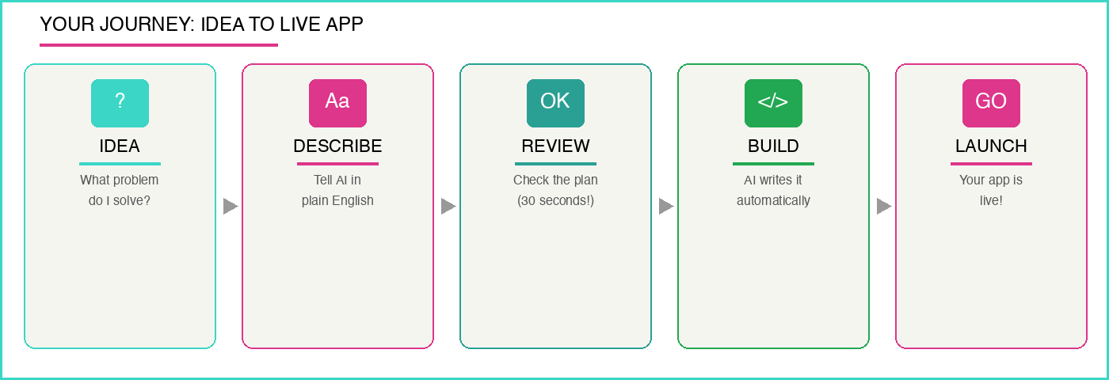
Your Journey: Idea to Live App
5 steps. Zero coding. You describe it, AI builds it.
The AI Cowboys | AFSA Summit 365 | Orlando, FL | August 2026

Slide 5
Your AI Toolkit: What Tool, When?
GenAI.mil
Deep research, build agents, process CUI/FOUO
IL5 Authorized
Your WORK tool
Google Antigravity
AI-powered IDE, describe apps in English
Personal Only
Your HOME tool
NotebookLM
Upload docs, ask questions, get cited answers
Zero hallucination
Your RESEARCH tool
Agent Designer
No-code AI agents inside GenAI.mil
103K+ built
Your QUICK tool
REMEMBER: Work data = GenAI.mil | Home practice = Antigravity with dummy data | Never mix.
The AI Cowboys | AFSA Summit 365 | Orlando, FL | August 2026

Slide 6
GenAI.mil: Your Work Tool
THE OFFICIAL DOW AI PLATFORM
Think of it as Google for government work,
but smarter and completely secure.
What can it do?
Answer complex research questions
Create AI agents that do tasks for you
Process CUI and FOUO documents safely
Summarize long reports in seconds
Login: Your CAC card
Your data is NEVER used to train AI models
BY THE NUMBERS
103K+
AI agents built in 5 weeks
1.1M
sessions logged
180K/wk
and growing
The AI Cowboys | AFSA Summit 365 | Orlando, FL | August 2026

Slide 7
Google Antigravity: Your Practice Tool
This is where you practice at home. For FREE.
You talk, it codes. Three surfaces working for you:
EDITOR: AI writes your code in real-time
TERMINAL: AI runs commands and installs stuff
BROWSER: AI launches your app and tests it visually
Multiple AI brains: Gemini, Claude, GPT
Download free: antigravity.google
HOME USE ONLY. Never put DoW data here!
The AI Cowboys | AFSA Summit 365 | Orlando, FL | August 2026

Slide 8
NotebookLM: Your Research Wingman
Upload docs. Ask questions. Get answers WITH citations.
How it works:
1. Upload SOPs, tech orders, AFIs, or any PDF
2. Ask: "What changed between v3 and v4 of this reg?"
3. NotebookLM answers ONLY from YOUR documents
4. Every answer cites the exact source paragraph
Normal AI can hallucinate (make stuff up).
NotebookLM ONLY uses what you gave it. Zero hallucination risk.
Also creates infographics, summaries, and audio overviews!
The AI Cowboys | AFSA Summit 365 | Orlando, FL | August 2026

Slide 9
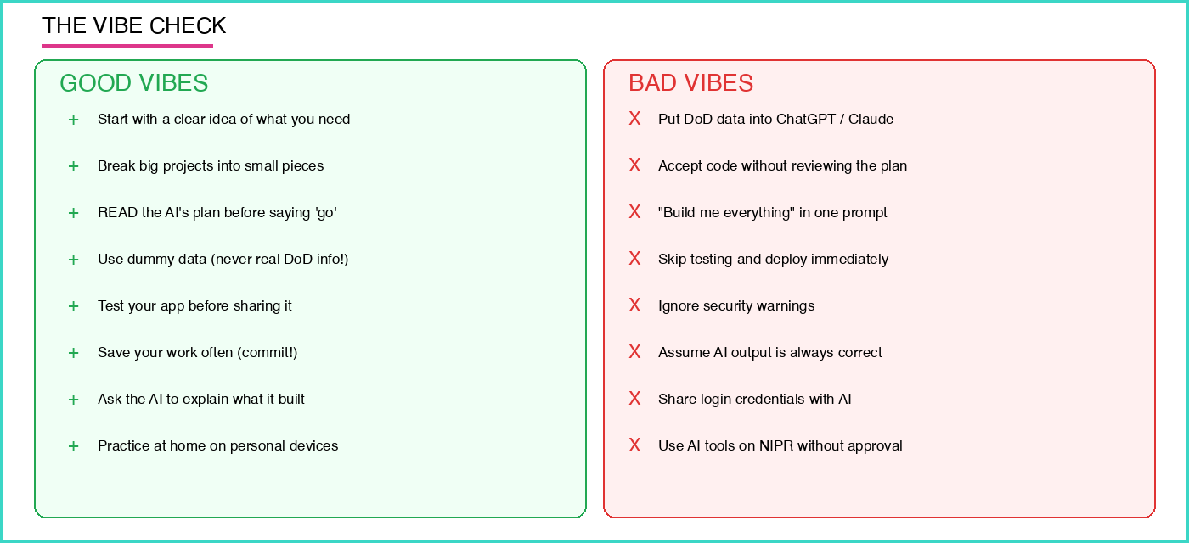
THE #1 RULE (Non-Negotiable)
At work = GenAI.mil with real data | At home = Antigravity with FAKE data | NEVER mix them.
The AI Cowboys | AFSA Summit 365 | Orlando, FL | August 2026

Slide 10
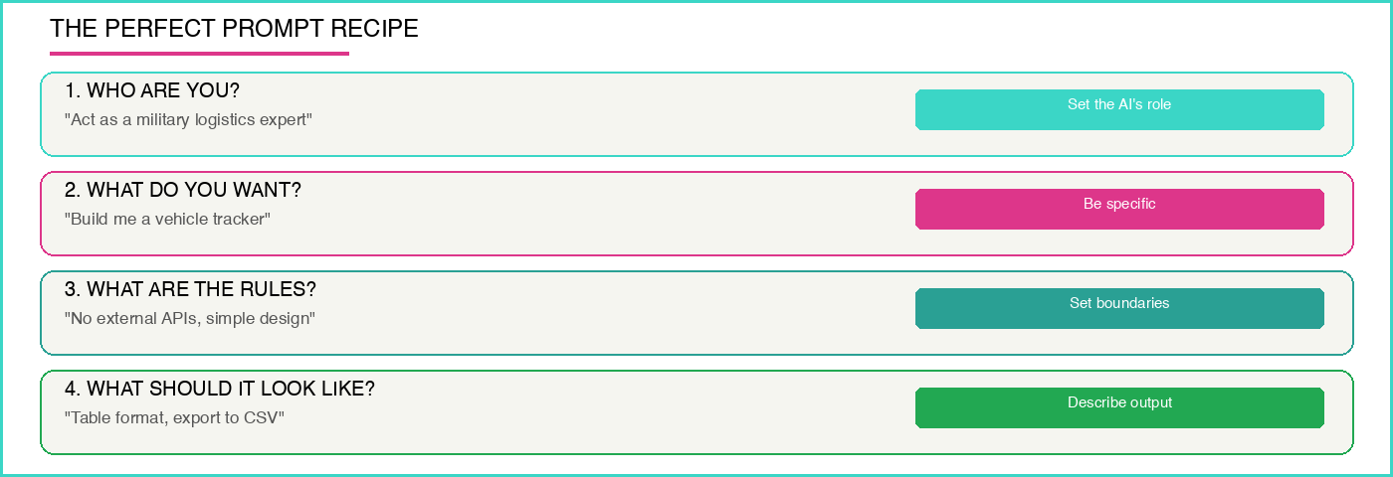
The Perfect Prompt Recipe
PRO TIP: Write your prompt in a notes app FIRST.
5 minutes of prompt writing saves 2 hours of headaches.
The AI Cowboys | AFSA Summit 365 | Orlando, FL | August 2026

Slide 11
Let's Build Something! (Live Demo)
01
I need a tool to track vehicle maintenance
THE IDEA
02
Open Antigravity + use our prompt recipe
DESCRIBE
03
AI shows us a plan, then we READ it (30 sec)
REVIEW
04
"Looks good, build it". AI writes everything
BUILD
05
AI opens browser, then we test it live
TEST
06
"Change colors to blue, add search", then iterate
ITERATE
The AI Cowboys | AFSA Summit 365 | Orlando, FL | August 2026

Slide 12
When Things Go Wrong (They Will!)
This is normal. Even experts iterate.
DON'T PANIC. DON'T START OVER.
Talk to the AI like you'd talk to a coworker:
BAD: "It's broken. Fix it."
GOOD: "The search bar doesn't show results when I
type a last name. Also the header should be blue, not green."
Be specific. Point to the problem. AI will fix it.
TRICK: Say "explain what you just built" to learn!
The AI Cowboys | AFSA Summit 365 | Orlando, FL | August 2026

Slide 13
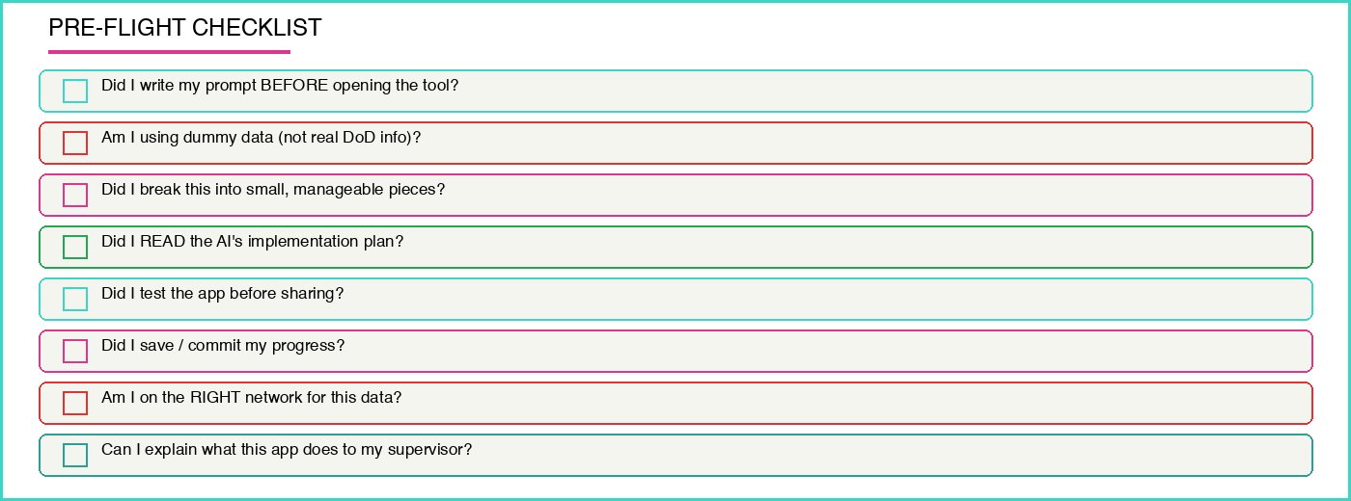
The Secret: Keep It Small
The #1 beginner mistake:
Trying to build EVERYTHING at once.
Instead, build in pieces:
Session 1: "Build the basic layout"
Session 2: "Add the data entry form"
Session 3: "Add search and filters"
Session 4: "Make it look professional"
Each session = one clear goal.
3 successful small sessions >
1 catastrophic big one
The AI Cowboys | AFSA Summit 365 | Orlando, FL | August 2026

Slide 14
The Security Reality Check
Vibe coding is powerful.
But power without safety = danger.
91.5% of vibe-coded apps have at least
one critical vulnerability.
$6.6 BILLION exposed in one incident.
The fix is simple:
READ the plan before you approve it
TEST before you share
Use DUMMY data while learning
Ask the AI to explain the security
91.5%
of vibe-coded apps have
critical vulnerabilities
(but YOU can fix this!)
The AI Cowboys | AFSA Summit 365 | Orlando, FL | August 2026

Slide 15
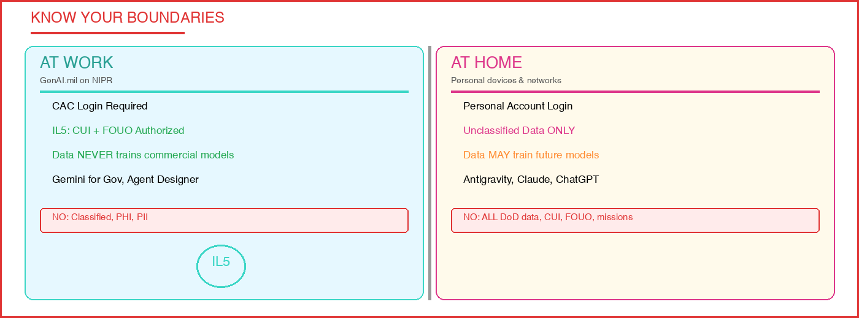
Government vs Home: Know Your Boundaries
This is career-ending if violated. No exceptions. No shortcuts.
The AI Cowboys | AFSA Summit 365 | Orlando, FL | August 2026

Slide 16
5 Steps to Safe Vibe Coding
01
DESCRIBE
Write a clear description of what you want
02
REVIEW
Read the AI's plan before approving (30 sec!)
03
BUILD
Let AI create it, watch for warnings
04
TEST
Try to break it yourself before sharing
05
SAVE
Commit your work so you never lose progress
The AI Cowboys | AFSA Summit 365 | Orlando, FL | August 2026

Slide 17
Ideas You Can Build TODAY
Vehicle Maintenance Tracker
Track status, dates, assign mechanics
Training Completion Dashboard
Who's current? Who's overdue?
Shift Schedule Builder
Input constraints, AI optimizes
Equipment Sign-Out Log
Replace the clipboard at the cage
After-Action Report Assistant
Structure AARs from bullet notes
PCS Checklist Generator
Personalized moving checklist
The AI Cowboys | AFSA Summit 365 | Orlando, FL | August 2026

Slide 18

YOUR TURN!
Open your laptops. Follow along.
We're building a real app together right now.
Use dummy data | Ask questions anytime | Have fun!

Slide 19
What You Learned Today
1
AI builds apps from plain English, no coding needed
2
GenAI.mil = work | Antigravity = home practice
3
NEVER put DoW data into commercial AI tools
4
Write prompts like a recipe: Who, What, Rules, Output
5
Keep projects small: one piece at a time
6
Always REVIEW the plan and TEST the output
7
When it breaks, describe the problem specifically
8
You are now a vibe coder. Use your powers wisely!
The AI Cowboys | AFSA Summit 365 | Orlando, FL | August 2026

Slide 20

Go Practice! (Resources)
GenAI.mil
Your work AI portal (CAC login)
genai.mil
Google Antigravity
Free IDE for home practice
antigravity.google
NotebookLM
Research & doc analysis
notebooklm.google.com
AFSA
Your professional association
hqafsa.org
Antigravity Codelabs
Step-by-step tutorials
codelabs.developers.google.com
The AI Cowboys | AFSA Summit 365 | Orlando, FL | August 2026

Slide 21

Questions?
Mike Pendleton & Roger Wong Won
The AI Cowboys
AFSA Summit 365 | Orlando, FL | August 2026
Scan to reach us
www.theaicowboys.com
You are now a vibe coder. Go build something amazing.

